Slide 1
Toward an Improvement of H.264 Video Transmission over IEEE 802.11e through a Cross-Layer Architecture by A. Ksentini, M. Naimi, and A. Gueroui
IEEE Communications Mag. Jan. 2006
Myungchul Kim
mck@kaist.ac.kr

Slide 2
Abstract
H.264 wireless video transmission over IEEE 802.11 WLAN by proposing a robust cross-layer architecture that leverages the inherent H.264 error resilience tools (i.e., data partitioning); and the existing QoS-based IEEE 802.11e MAC protocol possibilities
Graceful video degradation while minimizing the mean packet loss and end-to-end delays

Slide 3
Introduction
IEEE 802.11g/n
IEEE 802.11e
H.264/AVC
  Digital satellite TV 1.5 Mb/s comparing to MPEG-4 at 3 Mb/s
  Error resilience techniques: slice, data partitioning, flexible mac-block ordering (FMO)
  Not efficient
Cross layer: between the application layer and the MAC layer

Slide 4
H.264 Standard Overview
H.264
  Video coding layer (VCL): the specification of the core video compression engines such as motion compensation, transform coding of coefficients, and entropy coding,
    Transport-unaware
    A collection of coded macroblocks (MBs)
  Network abstraction layer (NAL) for the encapsulation of the coded slices into transport entities of the network
NAL
  NAL Units: one-byte header and a bit string for the MBs of a slice

Slide 5
H.264 Standard Overview
Parameter set concept (PSC)
  Higher-layer meta information such as picture size, display window, optional coding modes and et al should be sent reliably before transmitting video slices(cf. MPEG-4)
Error resilience tools: data partitioning
  MB-> slice -> data partition
  Partition A: header such as MB type, quantization parameters and motion vectors
  Partition B (intra partition): intra coded block pattern (CBP) and intra coefficients
  Partition C (inter partition): inter CBPs and inter coefficients

Slide 6
IEEE 802.11 Wireless LAN
Distributed Coordination Function (DCF)
  Busy -> backoff timer with Contention window (CW) -> the backoff timer expires and the medium is still free -> transmit
  In case of a collision: CW = (CW _{min} * 2 ^{i}) -1 until CW _{max}
  No differentiation mechanism for real-time and multimedia applications
EDCA: enhanced distributed access channel
  802.11e
  Access categories (AC): its own transmission queue and its own set of channel access parameters ?

Slide 7
Reliable video communication over WLAN
Automatic repeat request (ARQ)
  The receiver whether a transmission error occurred by calculating the check sequence
  Not suitable for multimedia streams
Forward error correction (FEC)
  Introducing parity checks
  Does not adapt to variable error channel conditions
    A waste of bandwidth may occur
    In sufficient error protection

Slide 8
Reliable video communication over WLAN
Cross-layer architectures for video transport over wireless networks [9]
  Top-down
  Bottom-up
  Application-centric approach
  MAC-centric approach
  Integrated approach

Slide 9
The proposed cross-layer architecture
VCL layer
  PSC -> IDR (may contain only I slice without data partitioning) -> A, B, C
NAL layer
  NAL header: Nal_Ref_Idc (NRI) field
  11(PSC), 10(IDR, A), 01(B, C), 00
IEEE 802.11e MAC layer
  AC3, AC2, AC1, AC0

Slide 10
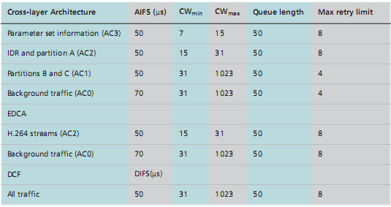
The proposed cross-layer architecture
Table 1. 802.11 MAC parameters

Slide 11
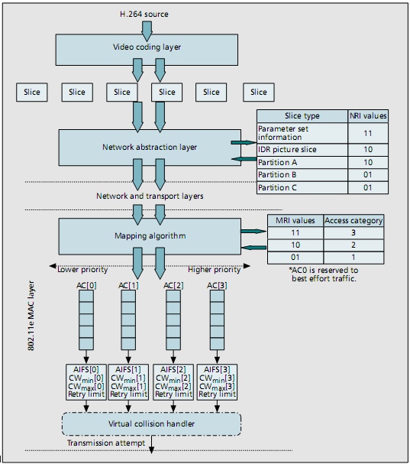
The proposed cross-layer architecture
Figure 1

Slide 12
Simulation and results
NS2
Simulation model
  H.264 Forman CIF sequence (10s): 25 frames/s
  At 2 Mb/s
  Background traffic CBR (300kb/s) over UDP
  Four wireless stations with 300 kb/s each using CBR
  15.1 s (5 s idle, PSC sent and then)
  RTP/UDP

Slide 13
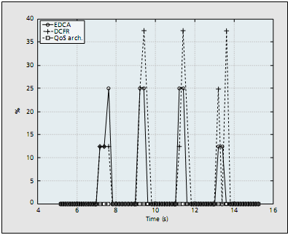
Simulation and results
Result analysis
  Fig 2 IDR loss rate

Slide 14
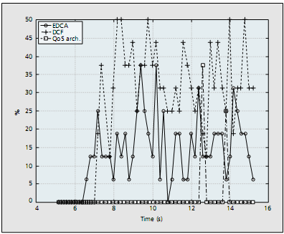
Simulation and results
Result analysis
  Fig 3 Partition A loss rate

Slide 15
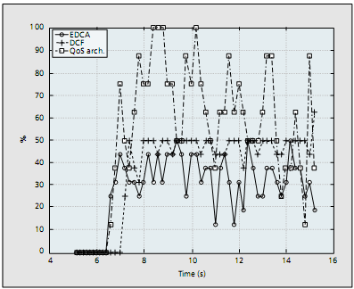
Simulation and results
Result analysis
  Fig 4 Partition B loss rate

Slide 16
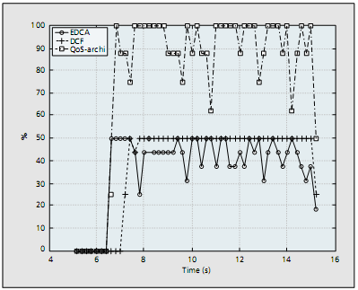
Simulation and results
Result analysis
  Fig 5 Partition C loss rate

Slide 17
Loss of partition B’s or C’s -> video degradation
Loss of partition A’s or IDR -> the frame dropped

Slide 18
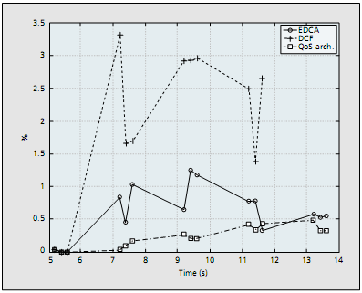
Simulation and results
Result analysis
  Fig 6 IDR packet delays

Slide 19
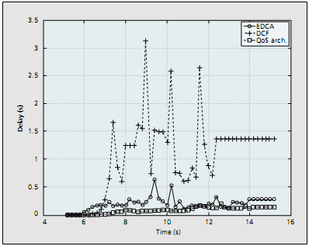
Simulation and results
Result analysis
  Fig 7 Partition A packet delays

Slide 20
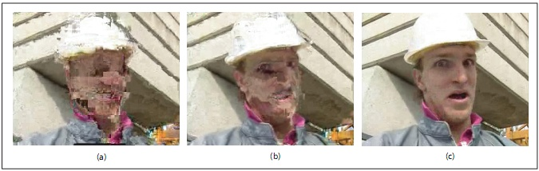
Simulation and results
Result analysis (final decoded frame #76)
  Dropped frames: DCF(87), EDCA(41) out of 250 frames
  Fig 8 a) DCF, b) EDCA, c) QoS architecture

